Slide 1
Network DEA in Insurance Industry
吳延東

Slide 2
Network DEA model (according to Hwang and Kao 2008)
資料取得
問題

Slide 3
Network DEA model (according to Hwang and Kao 2008)
資料取得
問題

Slide 4
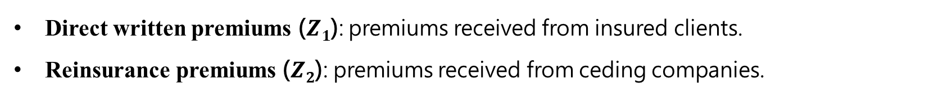
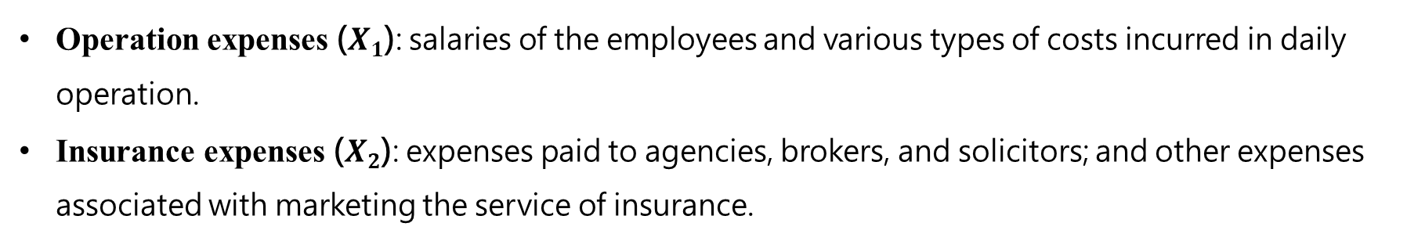
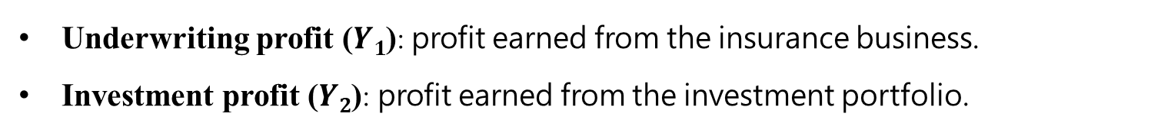
Network DEA model (according to Hwang and Kao 2008)
Network DEA in Insurance Industry
Operation expenses ($X1$): salaries of the employees and various types of costs incurred in daily operation.
Insurance expenses ($X2$): expenses paid to agencies, brokers, and solicitors; and other expenses associated with marketing the service of insurance.
Direct written premiums ($Z1$): premiums received from insured clients.
Reinsurance premiums ($Z2$): premiums received from ceding companies.
Underwriting profit ($Y1$): profit earned from the insurance business.
Investment profit ($Y2$): profit earned from the investment portfolio.

Slide 5
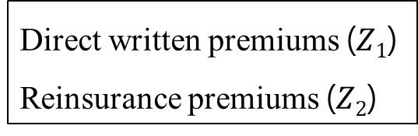
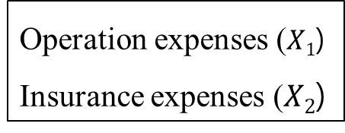
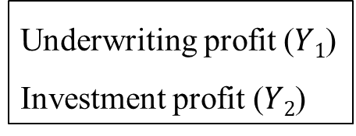
Network DEA model (according to Hwang and Kao 2008)
Network DEA in Insurance Industry
premium acquisition
profit generation
Operation expenses ($X1$)
Insurance expenses ($X2$)
Direct written premiums ($Z1$)
Reinsurance premiums ($Z2$)
Underwriting profit ($Y1$)
Investment profit ($Y2$)

Slide 6
Network DEA model (according to Hwang and Kao 2008)
資料取得
問題

Slide 7
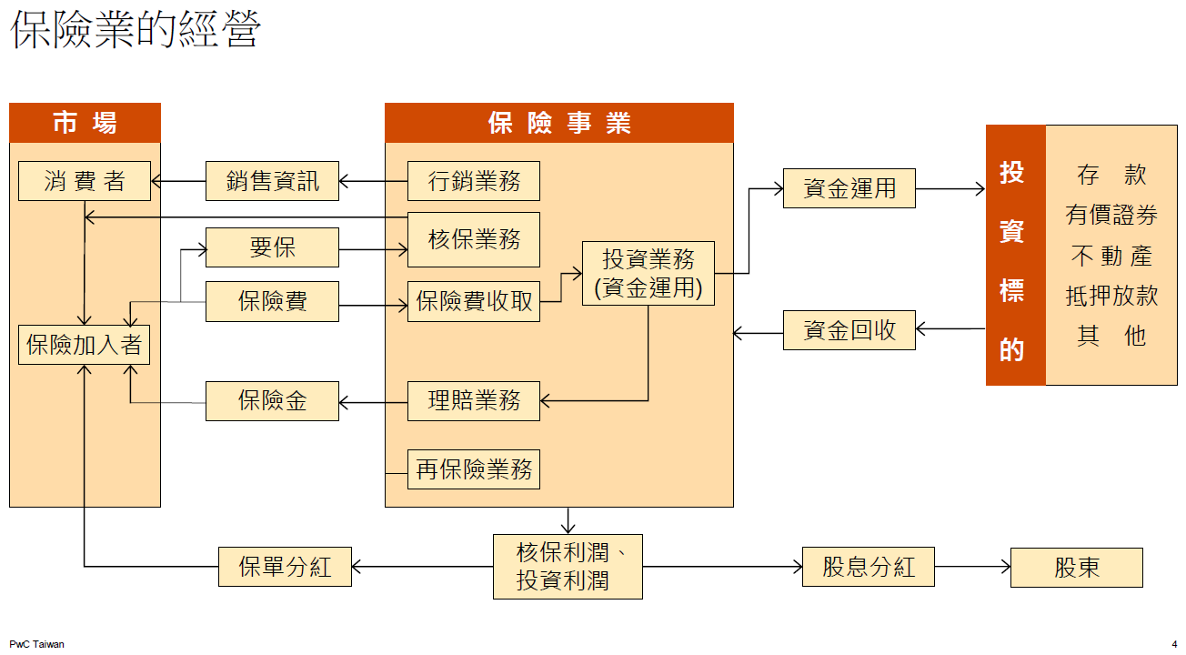
Network DEA in Insurance Industry

Slide 8
Network DEA in Insurance Industry
premium acquisition
profit generation

Slide 9
資料取得
Network DEA in Insurance Industry
premium acquisition
profit generation
Operation expenses ($X1$)
Insurance expenses ($X2$)
Direct written premiums ($Z1$)
Reinsurance premiums ($Z2$)
Underwriting profit ($Y1$)
Investment profit ($Y2$)

Slide 10
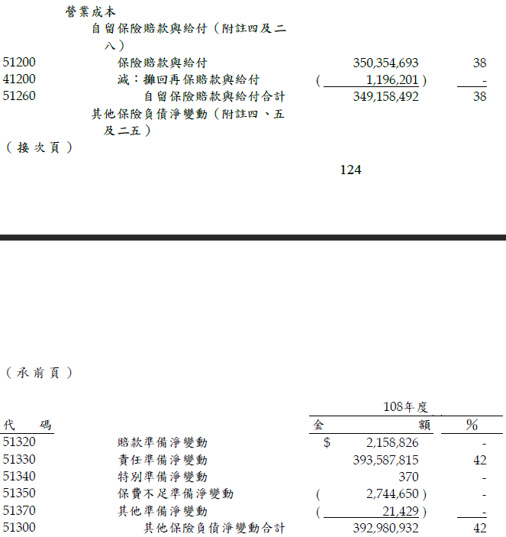
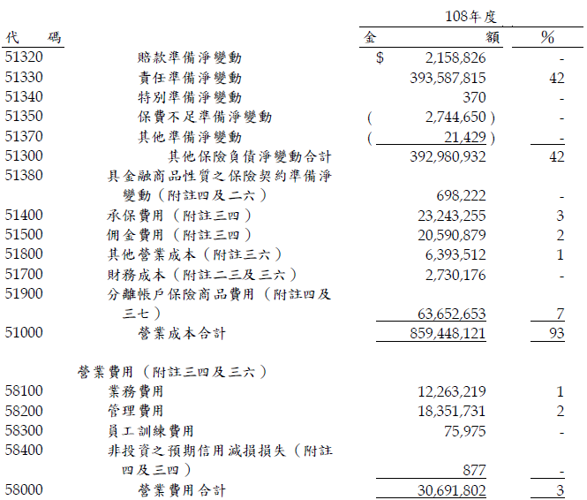
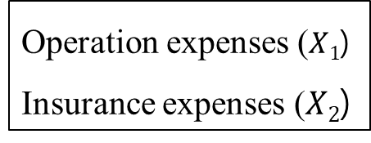
資料取得
Network DEA in Insurance Industry
人壽保險公司年報：綜合損益表
Operation expenses ($X1$)
Insurance expenses ($X2$)

Slide 11
資料取得
Network DEA in Insurance Industry
人壽保險公司年報：綜合損益表
Operation expenses ($X1$)
Insurance expenses ($X2$)

Slide 12
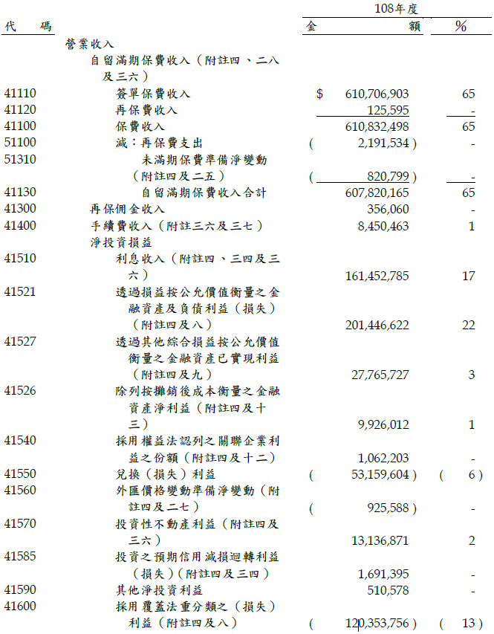
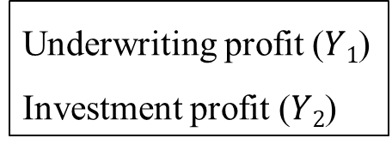
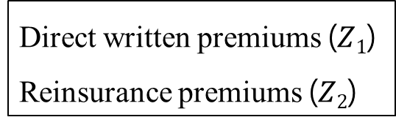
資料取得
Network DEA in Insurance Industry
人壽保險公司年報：綜合損益表
Direct written premiums ($Z1$)
Reinsurance premiums ($Z2$)
Underwriting profit ($Y1$)
Investment profit ($Y2$)

Slide 13
資料取得
Network DEA in Insurance Industry
人壽保險公司年報：綜合損益表
Direct written premiums ($Z1$)
Reinsurance premiums ($Z2$)
Underwriting profit ($Y1$)
Investment profit ($Y2$)

Slide 14
資料取得
Network DEA in Insurance Industry
人壽保險公司年報：綜合損益表
Direct written premiums ($Z1$)
Reinsurance premiums ($Z2$)
Underwriting profit ($Y1$)
Investment profit ($Y2$)

Slide 15
Network DEA model (according to Hwang and Kao 2008)
資料取得
問題

Slide 16
問題
Network DEA in Insurance Industry
再保佣金收入占比極低
Direct written premiums ($Z1$)
Reinsurance premiums ($Z2$)

Slide 17
問題
Network DEA in Insurance Industry
再保佣金收入占比極低
premium acquisition
profit generation
Operation expenses ($X1$)
Insurance expenses ($X2$)
Direct written premiums ($Z1$)
Reinsurance premiums ($Z2$)
Underwriting profit ($Y1$)
Investment profit ($Y2$)
是否可拿掉再保險佣金？

Slide 18
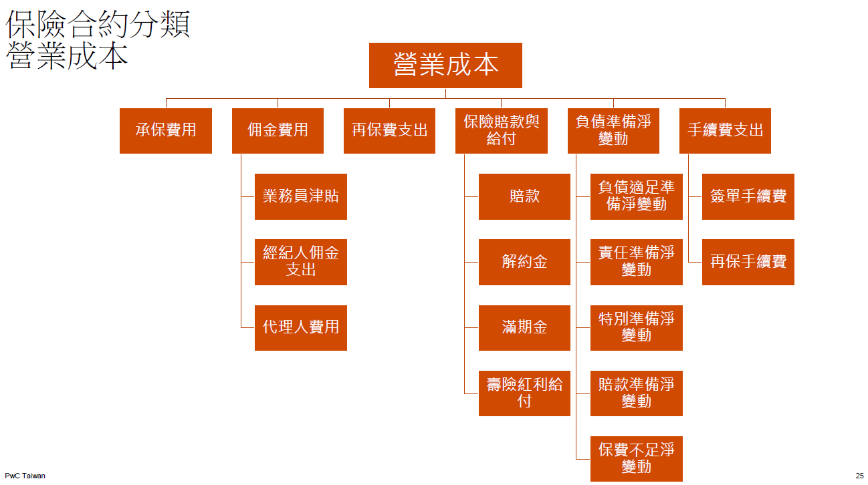
問題
Network DEA in Insurance Industry
負債準備佔成本比重高

Slide 19
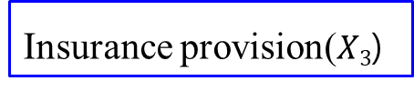
問題
Network DEA in Insurance Industry
負債準備佔成本比重高
premium acquisition
profit generation
Operation expenses ($X1$)
Insurance expenses ($X2$)
Direct written premiums ($Z1$)
Reinsurance premiums ($Z2$)
Underwriting profit ($Y1$)
Investment profit ($Y2$)
Insurance provision($X3$)
是否可加入負債準備？

Slide 20
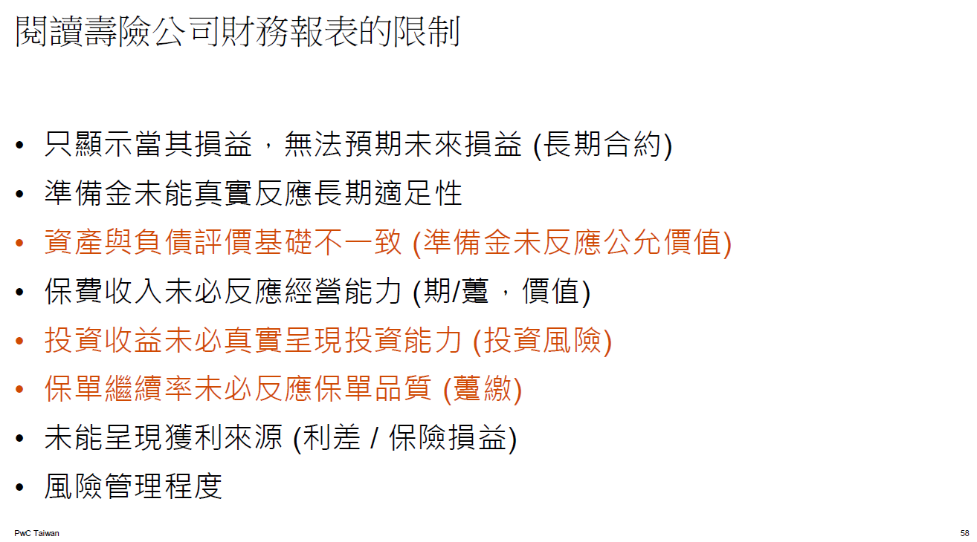
問題
Network DEA in Insurance Industry

